Slide 1
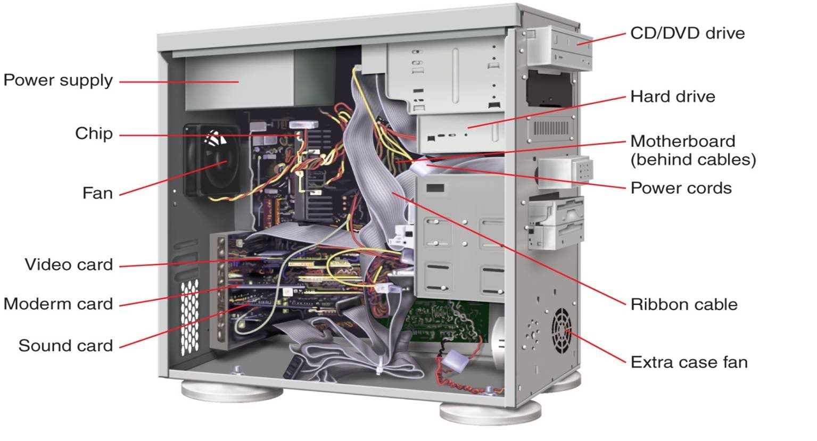
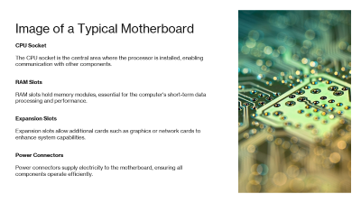
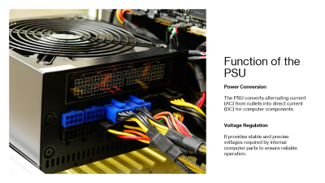
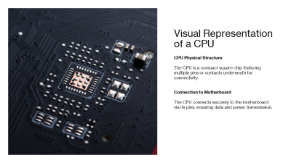
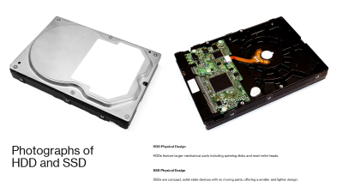
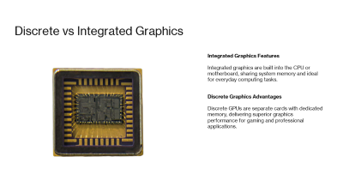
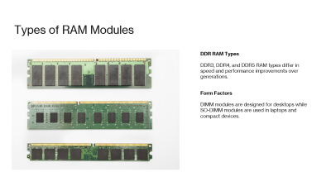

Slide 2
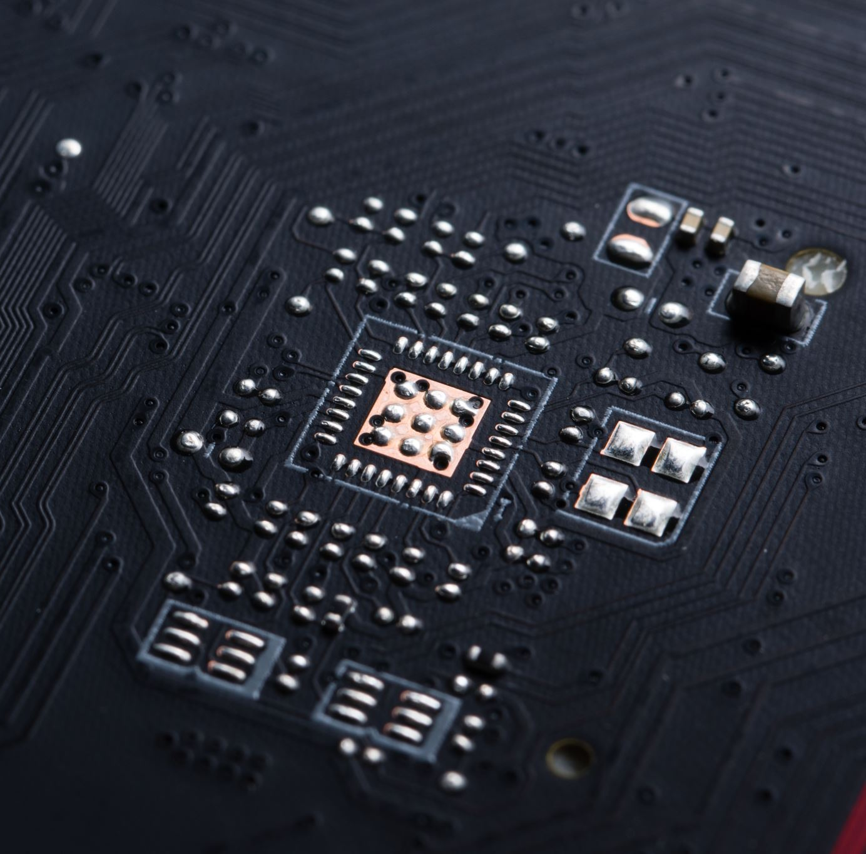
Visual Representation of a CPU
CPU Physical Structure
  The CPU is a compact square chip featuring multiple pins or contacts underneath for connectivity.
Connection to Motherboard
  The CPU connects securely to the motherboard via its pins, ensuring data and power transmission.
Notes:
---
A typical CPU is a small square chip with numerous pins or contacts on its underside. This slide will display the layout and design, illustrating how it connects to the motherboard.
Image source: Microsoft 365 content library

Slide 3
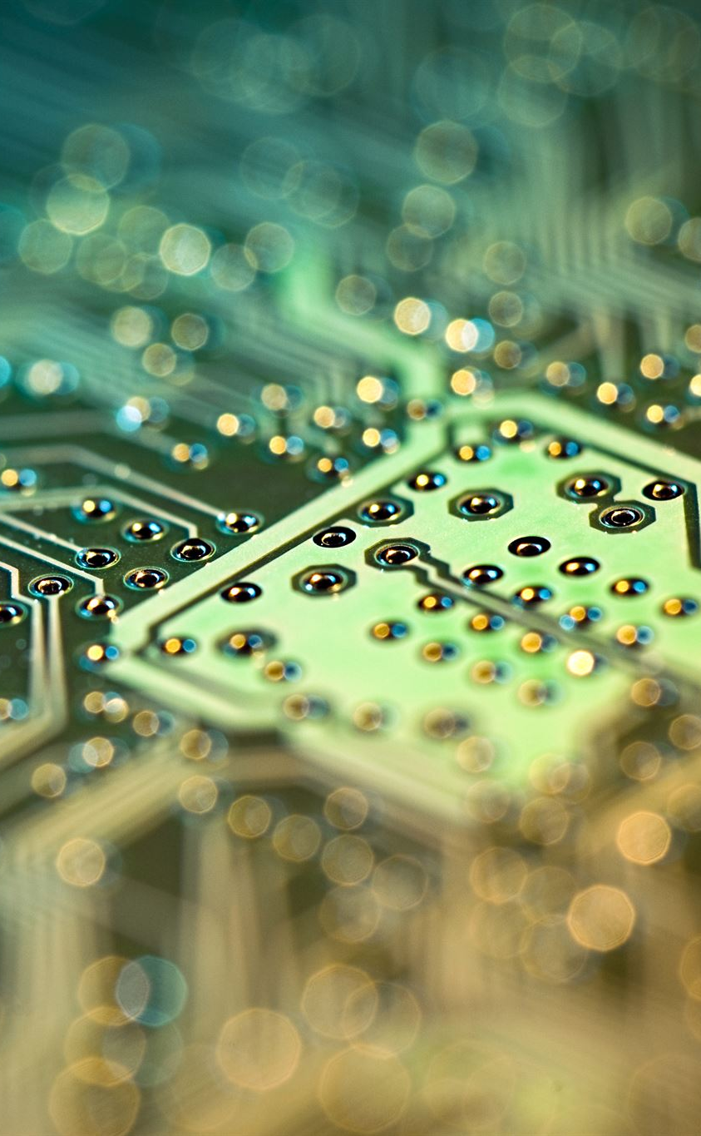
Image of a Typical Motherboard
CPU Socket
  The CPU socket is the central area where the processor is installed, enabling communication with other components.
RAM Slots
  RAM slots hold memory modules, essential for the computer's short-term data processing and performance.
Expansion Slots
  Expansion slots allow additional cards such as graphics or network cards to enhance system capabilities.
Power Connectors
  Power connectors supply electricity to the motherboard, ensuring all components operate efficiently.
Notes:
---
This slide shows a typical motherboard layout, highlighting the CPU socket, RAM slots, expansion slots, and power connectors to provide an understanding of its physical design.
Image source: Microsoft 365 content library

Slide 4
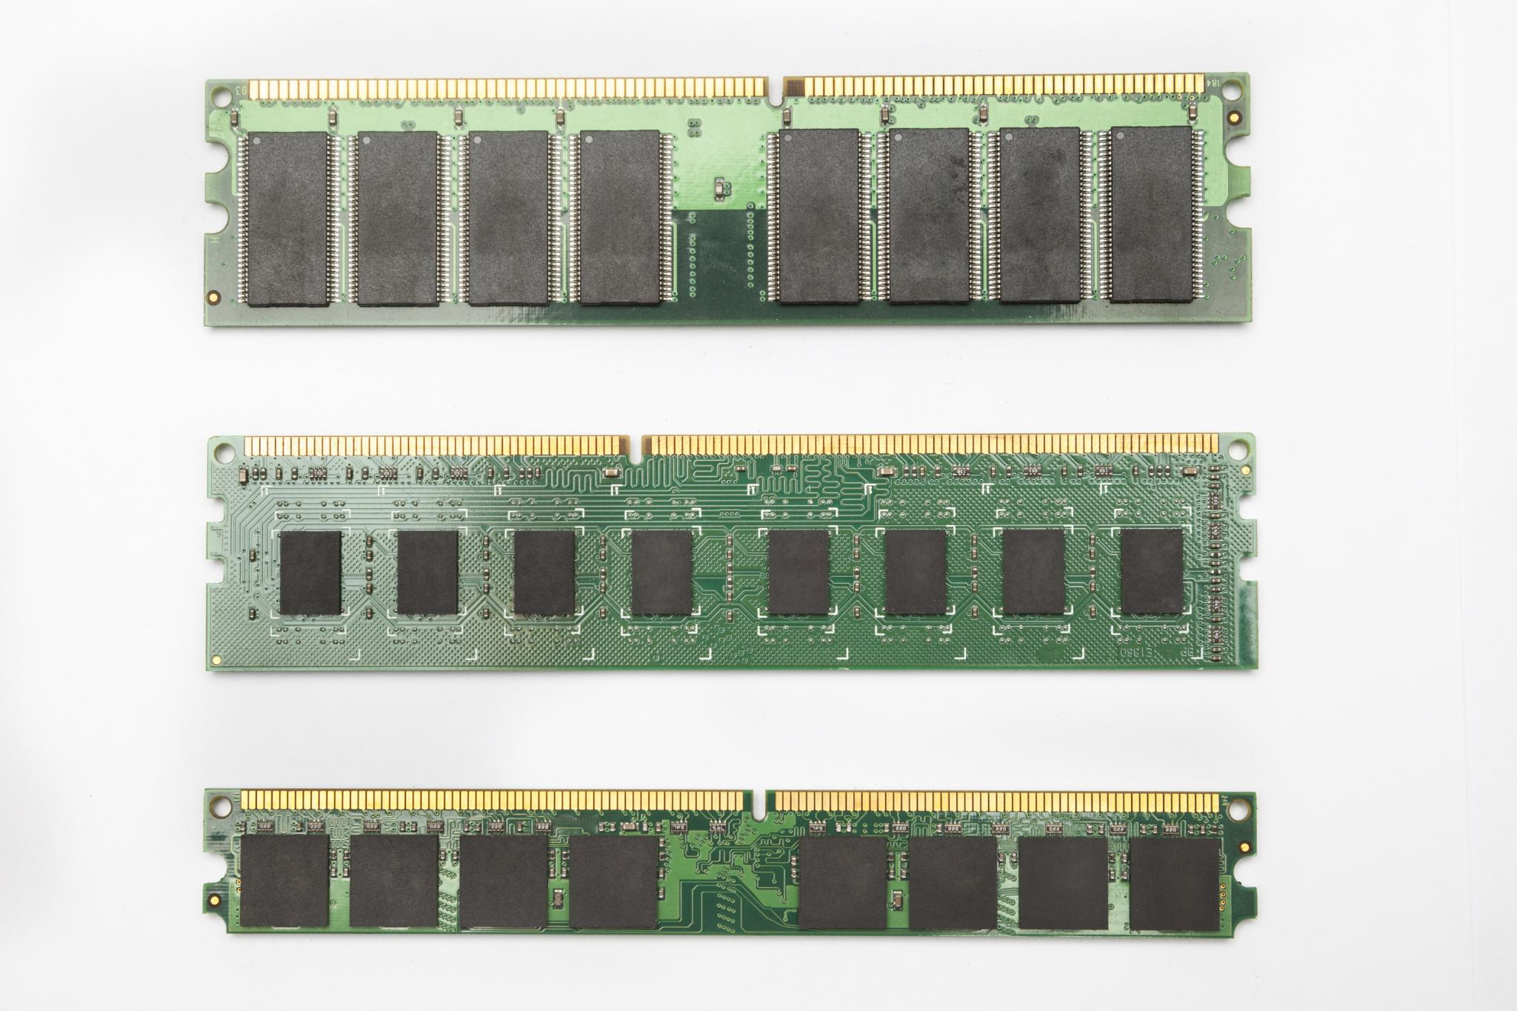
Types of RAM Modules
DDR RAM Types
  DDR3, DDR4, and DDR5 RAM types differ in speed and performance improvements over generations.
Form Factors
  DIMM modules are designed for desktops while SO-DIMM modules are used in laptops and compact devices.
Notes:
---
Common RAM types include DDR3, DDR4, and the newer DDR5, each offering different speeds and performance enhancements. Form factors like DIMM and SO-DIMM are used for desktops and laptops respectively.
Image source: Microsoft 365 content library

Slide 5
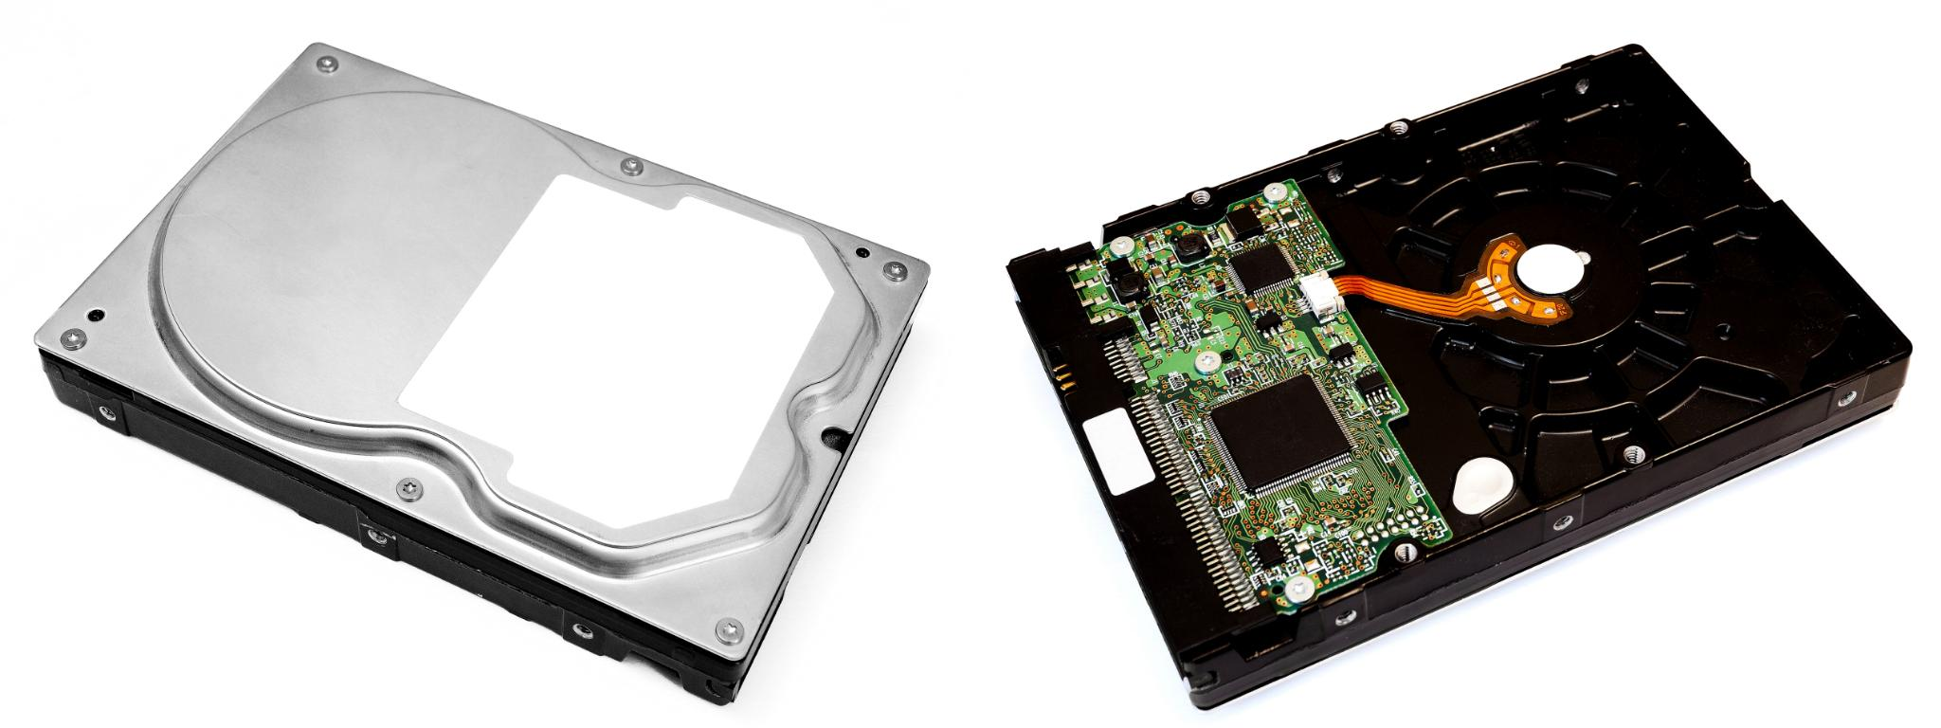
Photographs of HDD and SSD
HDD Physical Design
  HDDs feature larger mechanical parts including spinning disks and read-write heads.
SSD Physical Design
  SSDs are compact, solid-state devices with no moving parts, offering a smaller and lighter design.
Notes:
---
Images of a traditional hard disk drive and a solid-state drive illustrate their different physical designs, with HDDs having larger mechanical parts and SSDs being compact and solid-state.
Image source: Microsoft 365 content library

Slide 6
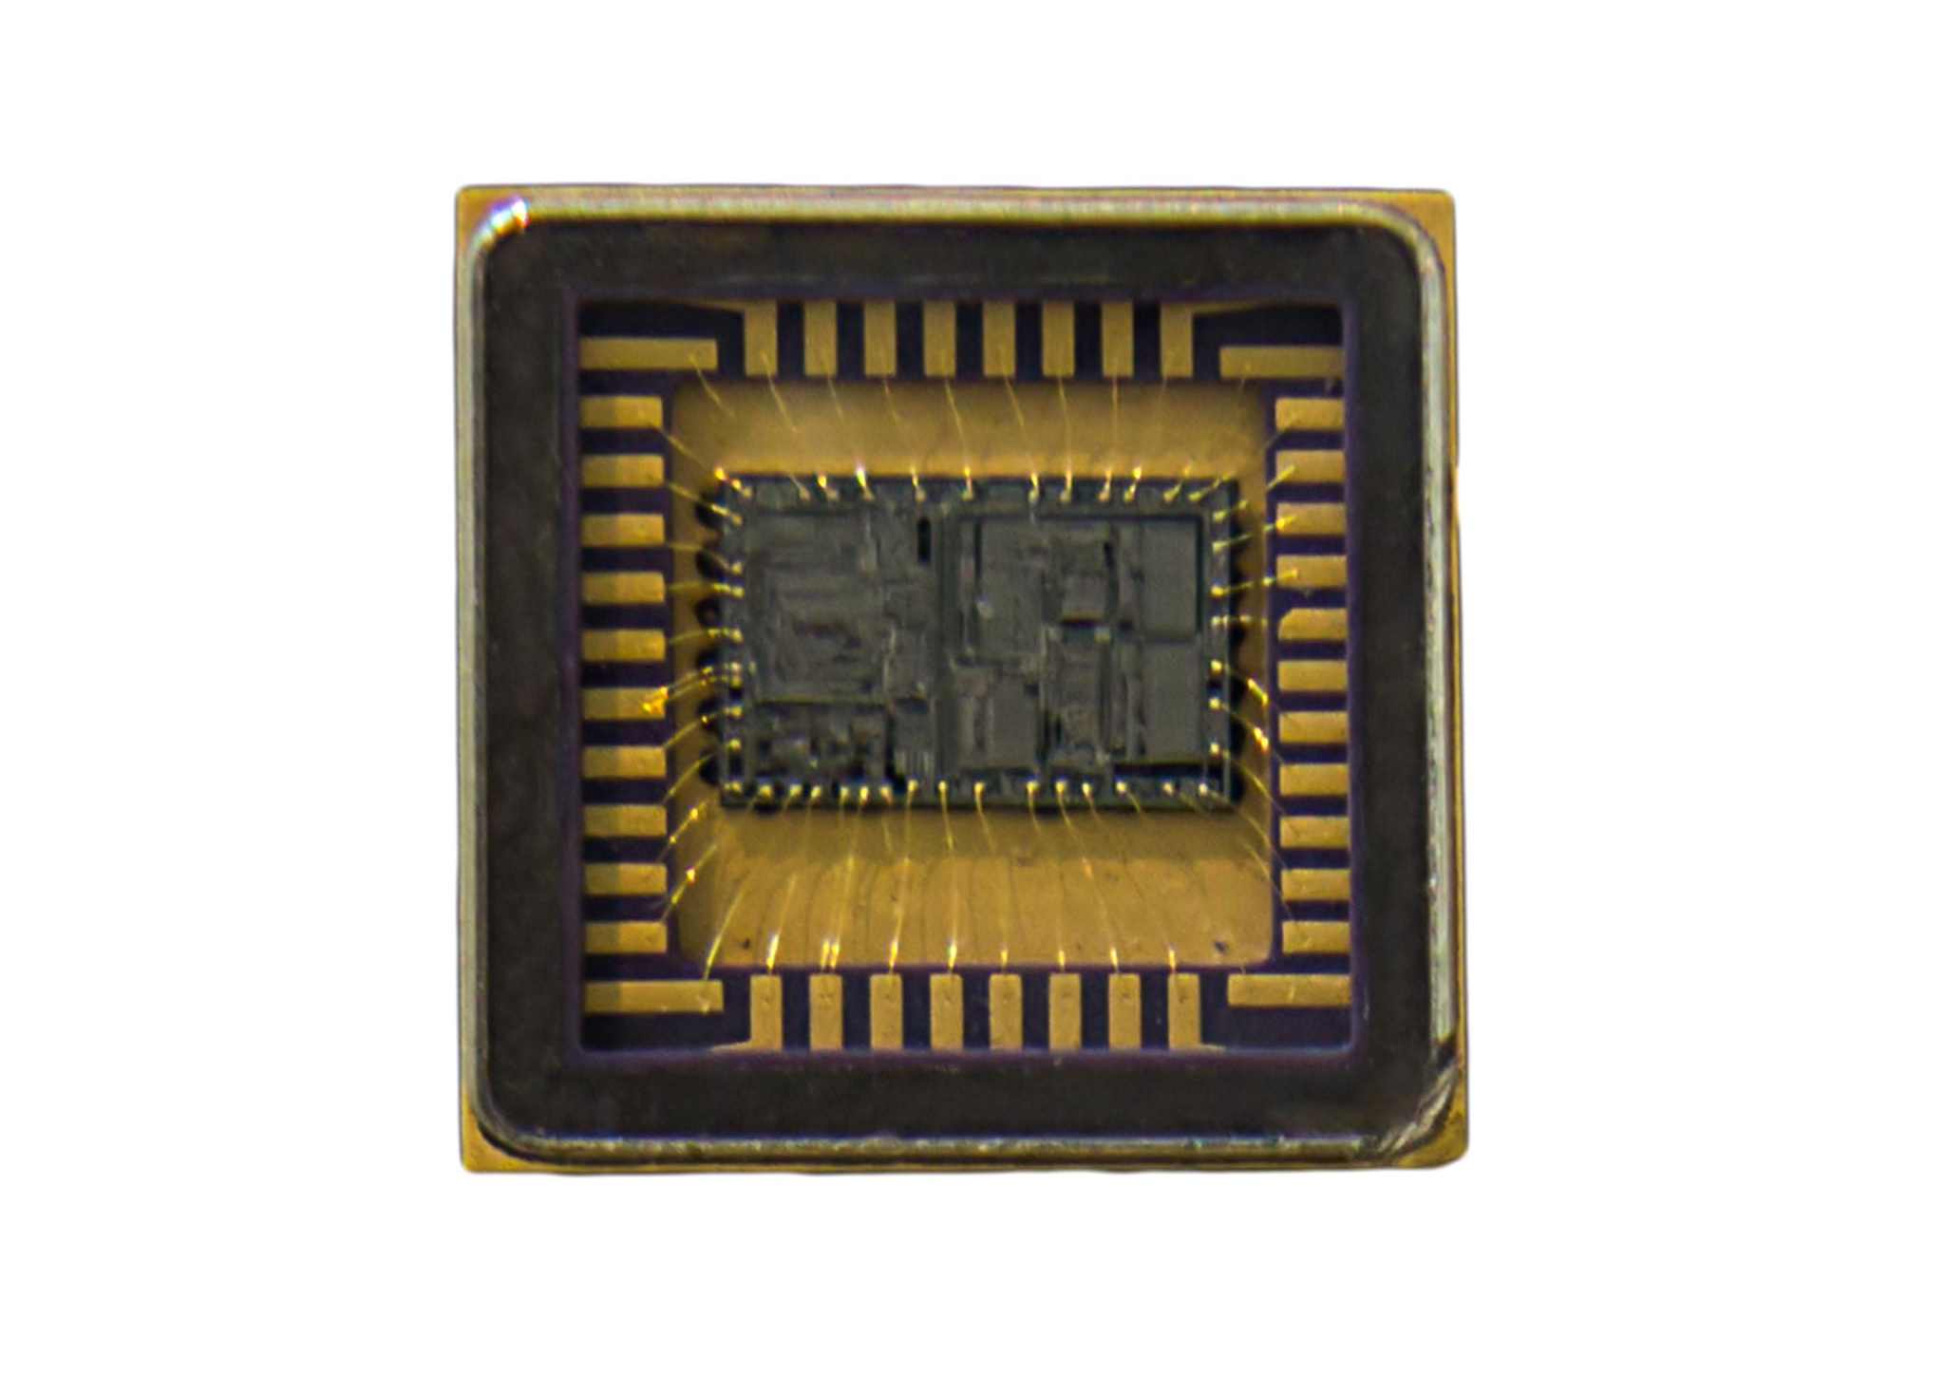
Discrete vs Integrated Graphics
Integrated Graphics Features
  Integrated graphics are built into the CPU or motherboard, sharing system memory and ideal for everyday computing tasks.
Discrete Graphics Advantages
  Discrete GPUs are separate cards with dedicated memory, delivering superior graphics performance for gaming and professional applications.
Notes:
---
Integrated graphics are built into the CPU or motherboard and share memory, suitable for everyday use. Discrete GPUs are separate cards with dedicated memory, offering superior performance for demanding tasks.
Image source: Microsoft 365 content library

Slide 7
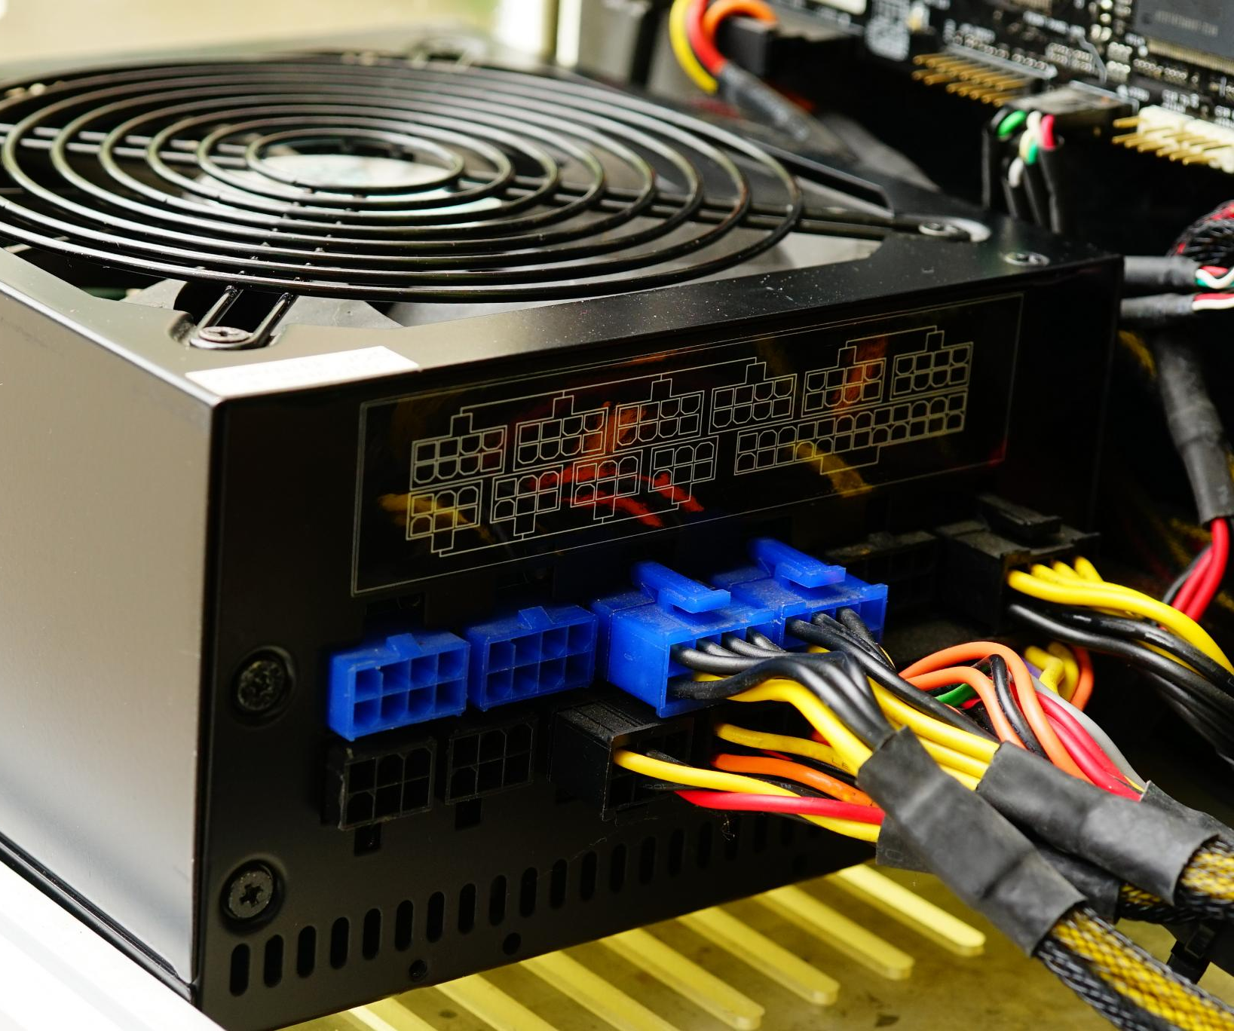
Function of the PSU
Power Conversion
  The PSU converts alternating current (AC) from outlets into direct current (DC) for computer components.
Voltage Regulation
  It provides stable and precise voltages required by internal computer parts to ensure reliable operation.
Notes:
---
The PSU converts AC power from an outlet into DC power at the voltages needed by the computer’s internal components, ensuring stable and reliable operation.
Image source: Microsoft 365 content library

